Slide 1

INTERNSHIP/MINI PROJECT ASSESSMENT PRESENTATION SESSION 2021-22
Department of Information Technology
ABES Engineering College
Name- Aditya Khandelwal
Class & Section: IT-A
Roll No. – 1803213008
Admission No. – 2018BIT1159

Slide 2
Contents:-
About the platform
Objectives of course
Course Modules
Course Description
Challenges and limitations
Project Screenshots
Code Snippets

Slide 3
Platform used:
Coursera
Coursera Inc. is an American massive open online course provider founded in 2012 by Stanford University computer science professors Andrew Ng and Daphne Koller. Coursera works with universities and other organizations to offer online courses, certifications, and degrees in a variety of subjects.
Coursera courses last approximately four to twelve weeks, with one to two hours of video lectures a week. These courses provide quizzes, weekly exercises, peer-graded and reviewed assignments, an optional Honors assignment, and sometimes a final project or exam to complete the course.[44] Courses are also provided on-demand, in which case users can take their time in completing the course with all of the material available at once. As of May 2015, Coursera offered 104 on-demand courses. They also provide guided projects which are short 2-3 hour projects that can be done at home.

Slide 4
Objectives of the course
To learn and implement the following technologies:-
HTML
CSS
JAVASCRIPT

Slide 5
Course modules
Introduction to HTML5
Introduction to CSS3
Introduction to JavaScript
Using the above technologies to build a web application

Slide 6
HTML
Hypertext Markup Language (HTML) is the standard markup language for documents designed to be displayed in a web browser. It can be assisted by technologies such as Cascading Style Sheets (CSS) and scripting languages such as JavaScript.
CSS
CSS is designed to enable the separation of presentation and content, including layout, colors, and fonts. This separation can improve content accessibility; provide more flexibility and control in the specification of presentation characteristics; enable multiple web pages to share formatting by specifying the relevant CSS in a separate
JavaScript
JavaScript often abbreviated as JS, is a programming language that conforms to the ECMAScript specification. JavaScript is high-level, often just-in-time compiled, and multi-paradigm. It has curly-bracket syntax, dynamic typing, prototype-based object-orientation, and first-class functions.

Slide 7
Challenges and limitations
Difficulty in combining different technologies.
With CSS, what works with one browser might not always work with another.
Client-Side Security. Because the code executes on the users’ computer, in some cases it can be exploited for malicious purposes

Slide 8
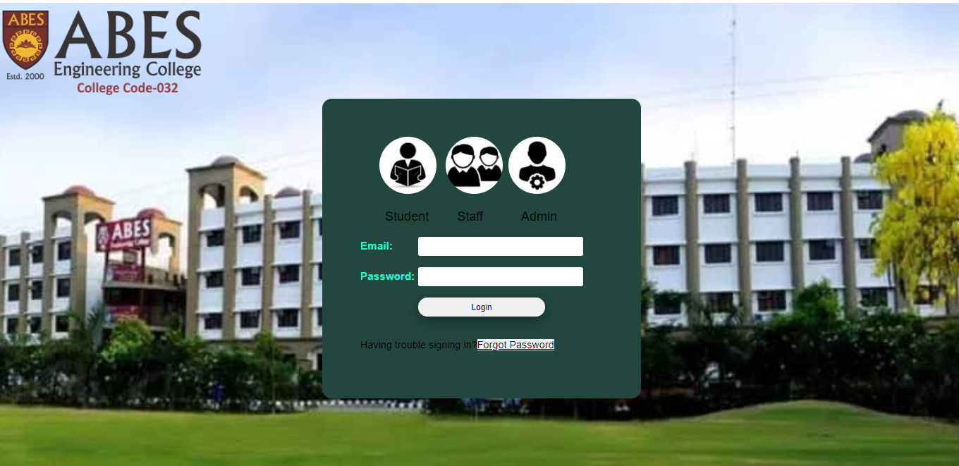
Project Screenshots Login Page

Slide 9
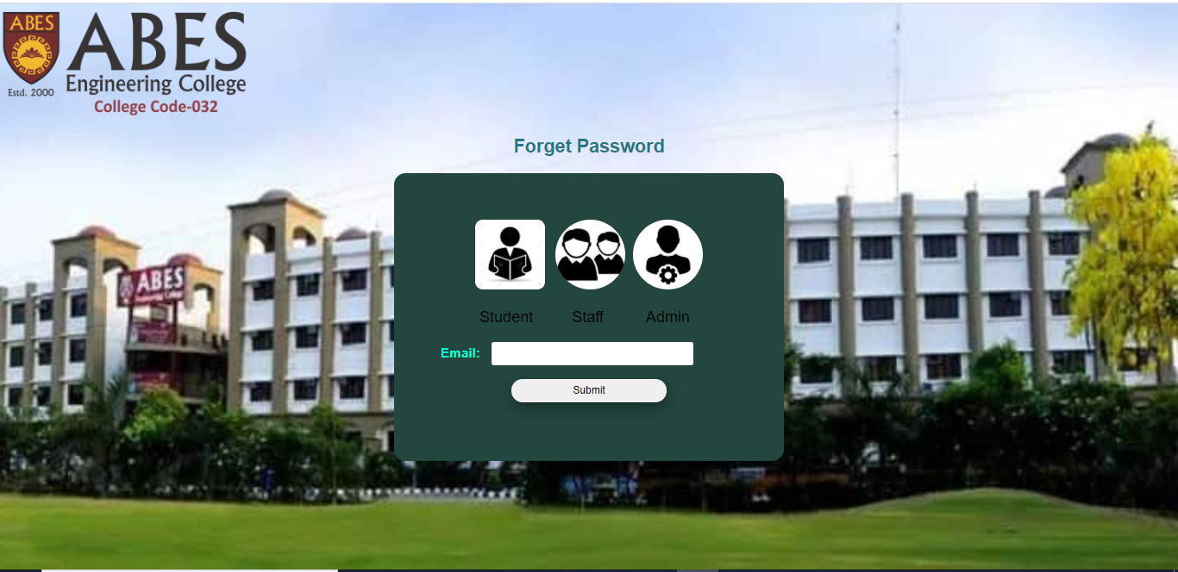
Forget Password

Slide 10
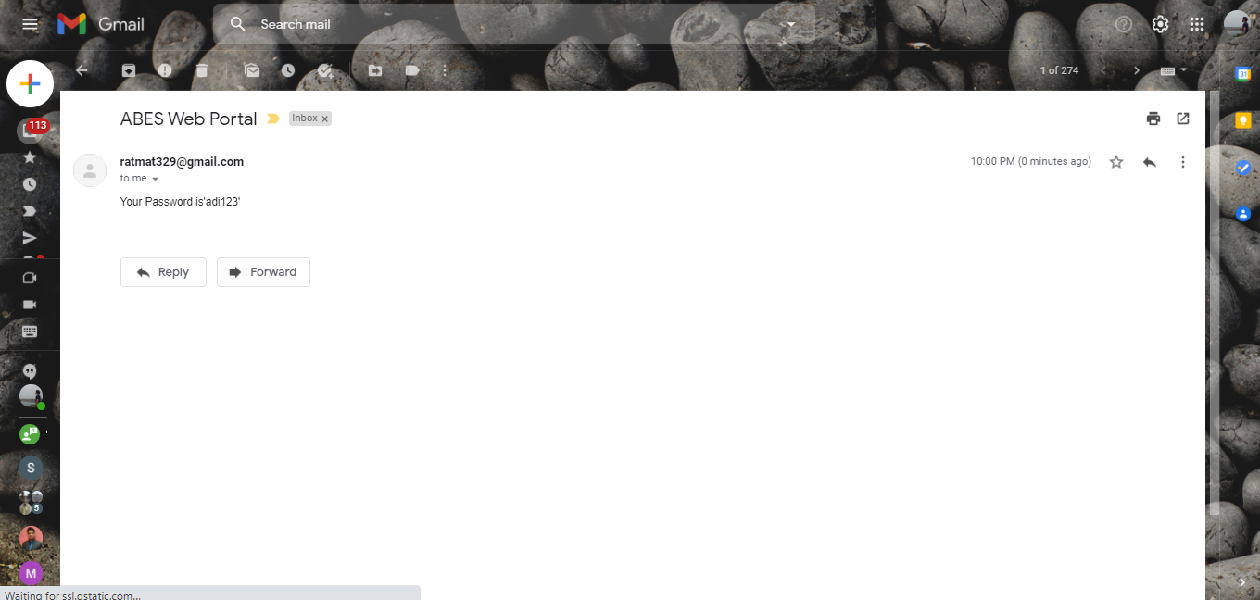
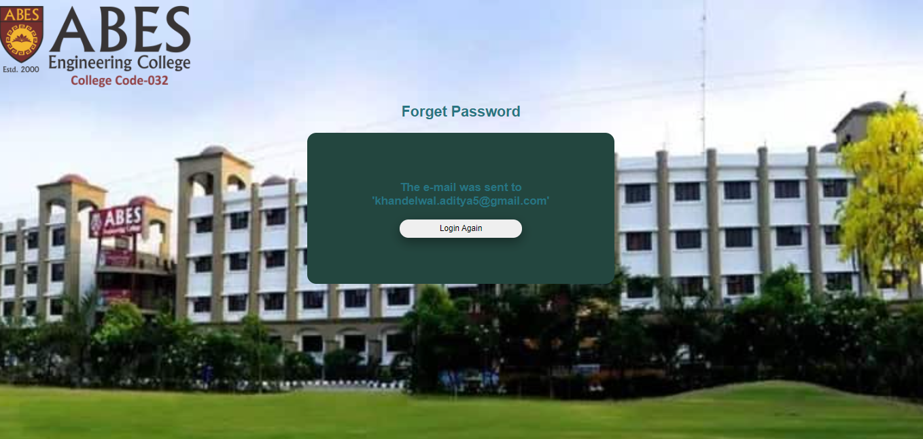
Password sent to Email

Slide 11
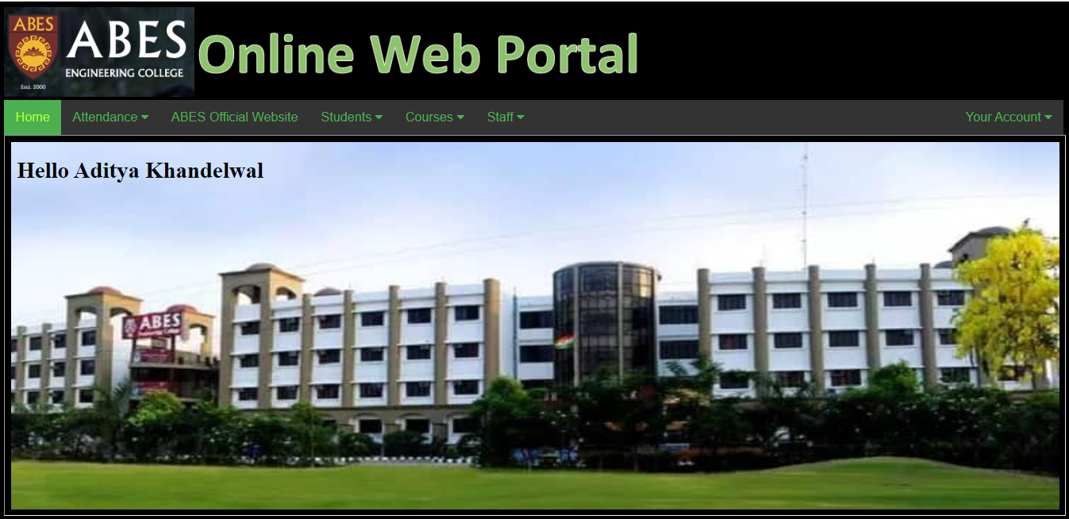
Home Page Admin Login

Slide 12
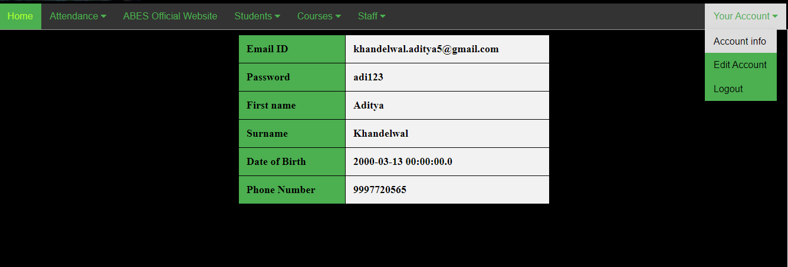
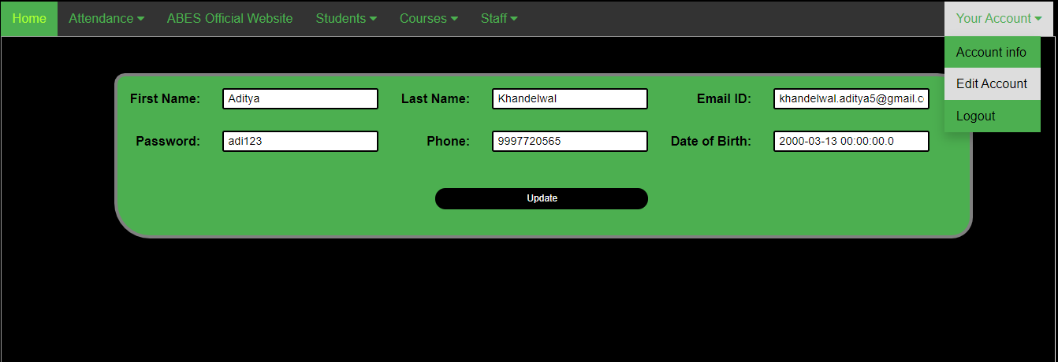
Account Info
Edit Account

Slide 13
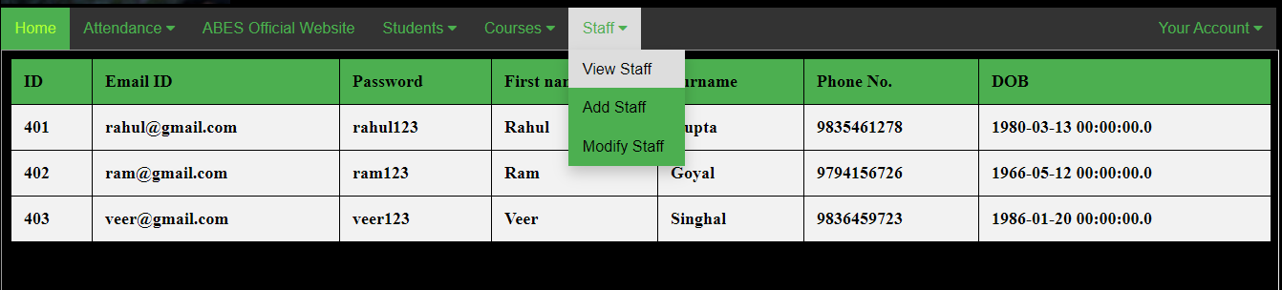
View Staff

Slide 14
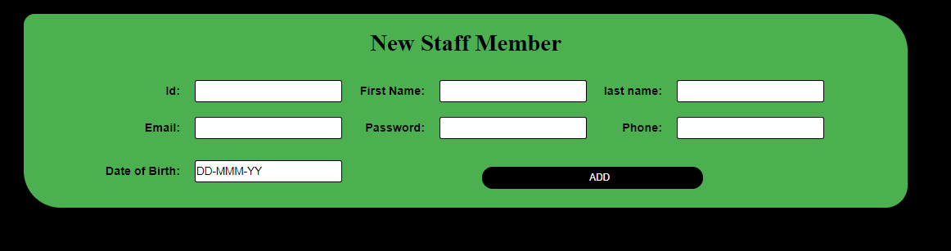
Add Staff

Slide 15
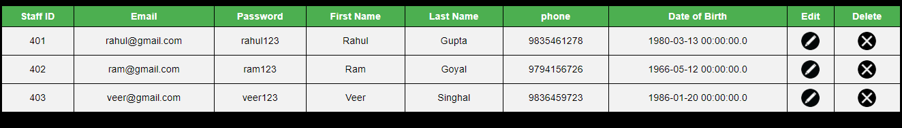
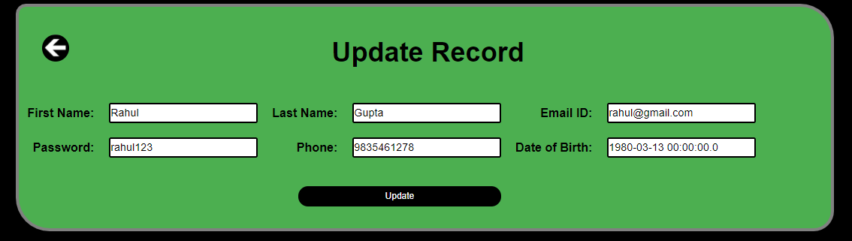
Modify Staff
Edit & Delete

Slide 16
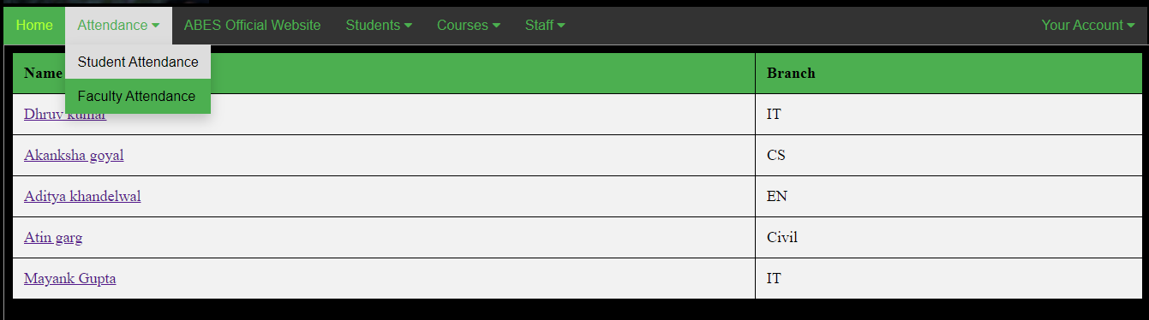
Student Attendance

Slide 17
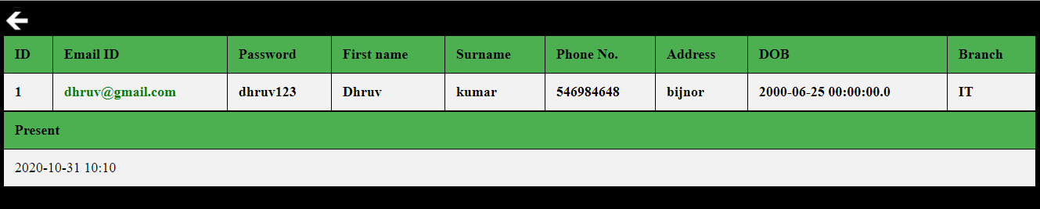
Attendance Record

Slide 18
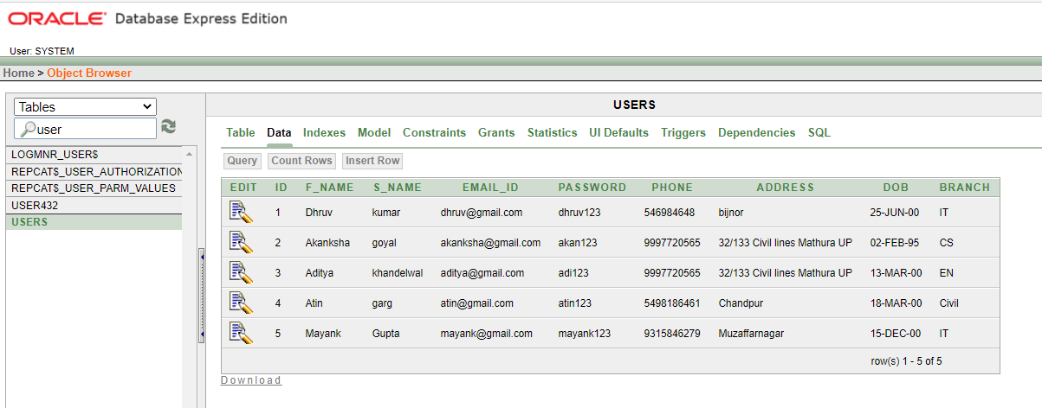
Oracle Database

Slide 19
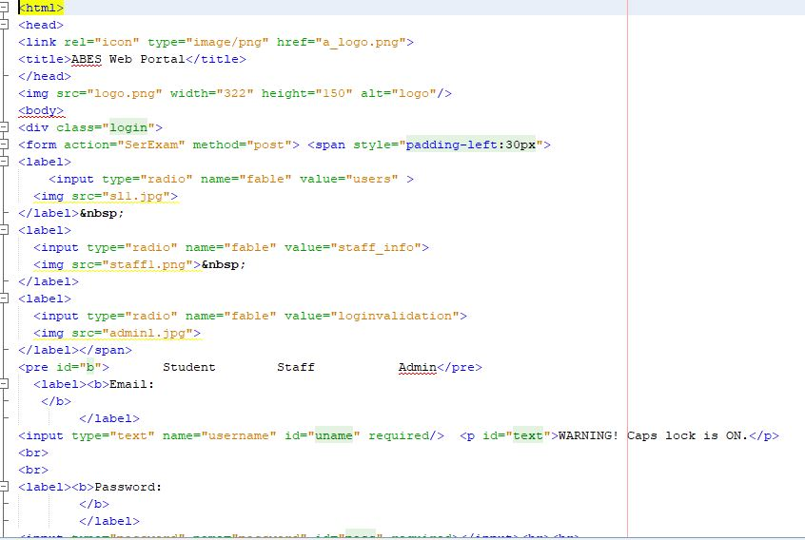
Code snippets
Login page

Slide 20
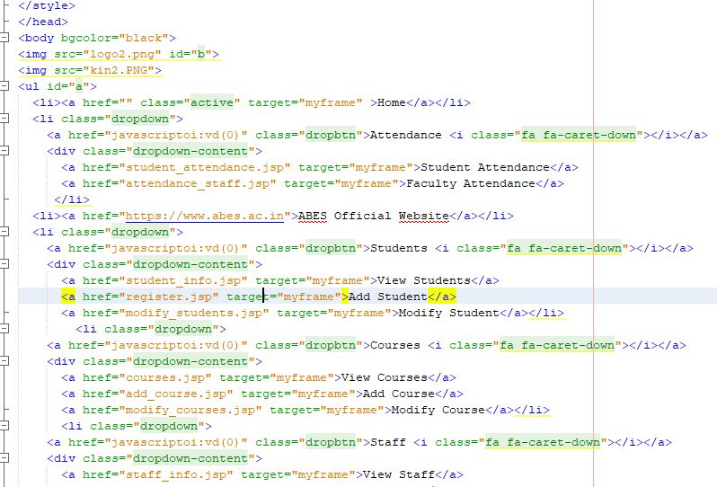
Home Page

Slide 21
Thank You

